Slide 1
ShanghaiTech University
EE 115B: Digital Circuits
Fall 2021
Lecture 6
Hengzhao Yang
October 14, 2021

Slide 2

EE115 Analog and Digital Circuits
Topic 5: Boolean Algebra and
Logic Simplification
Prof. Yajun Ha
ShanghaiTech University
Shanghai, China
Part of this set of slides is by © Pearson Education

Slide 3

Boolean Algebra and Logic Simplification
Boolean Algebra
Logic Simplification
  Karnaugh Map
  Quine-McCluskey Method
Prof. Yajun Ha

Slide 4
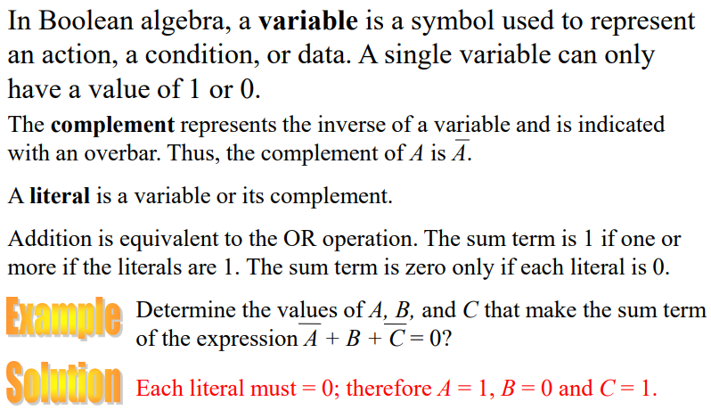
Boolean Addition

Slide 5
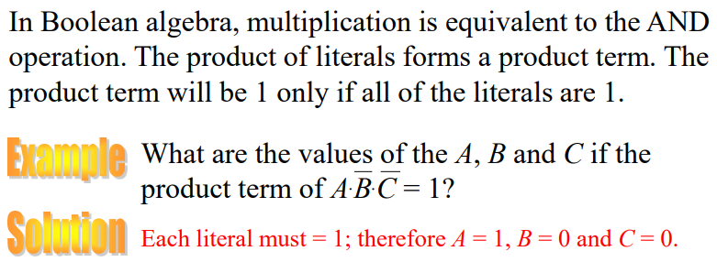
Boolean Multiplication
Prof. Yajun Ha
Notes:
Title

Slide 6
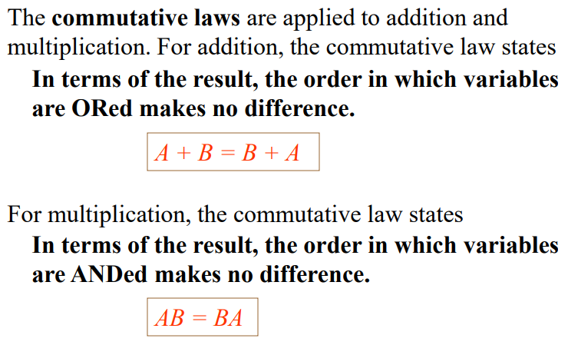
Commutative Laws
Prof. Yajun Ha
Notes:
Title

Slide 7
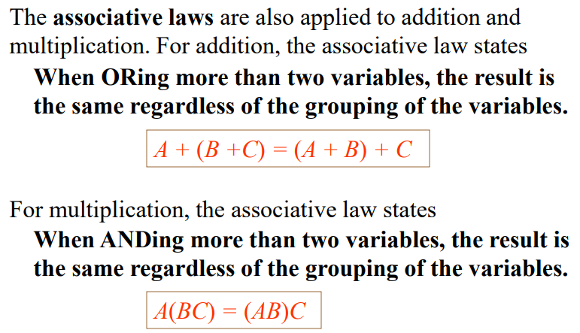
Associative Laws

Slide 8
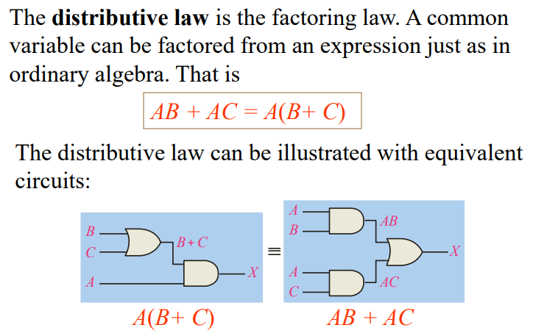
Distributive Law
Prof. Yajun Ha
Notes:
Title

Slide 9
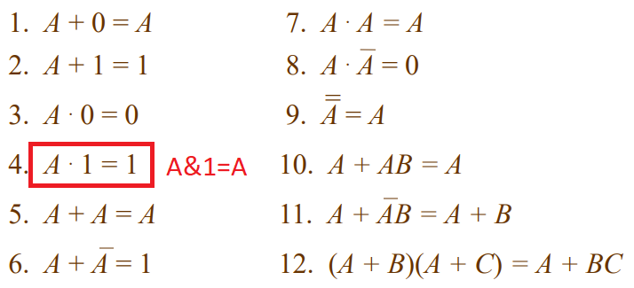
Rules of Boolean Algebra (1)
Prof. Yajun Ha
Notes:
Title

Slide 10

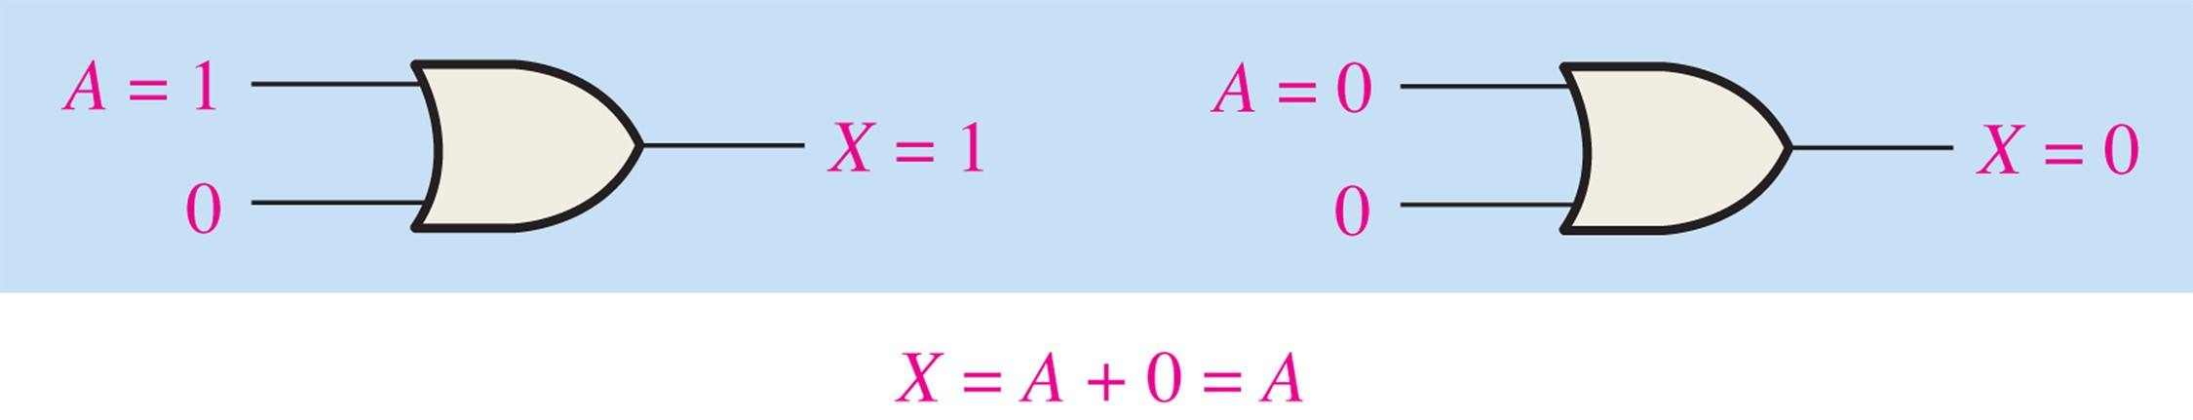
FIGURE 4-8

Slide 11
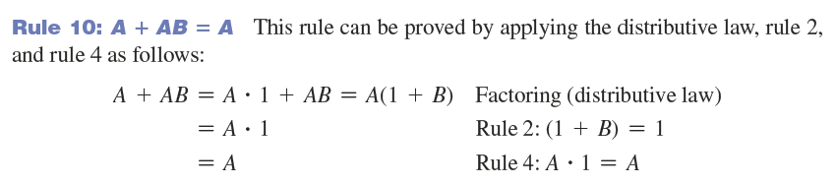
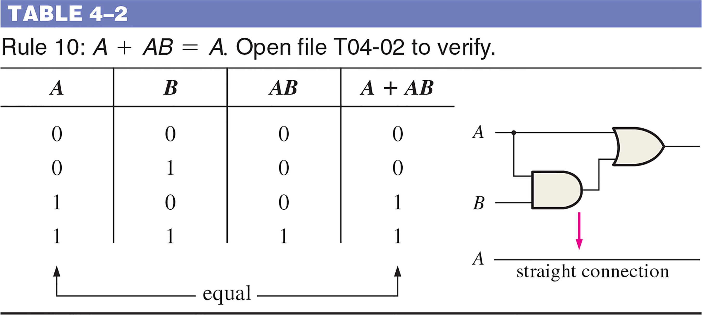
TABLE 4–2 Rule 10: A + AB = A.

Slide 12
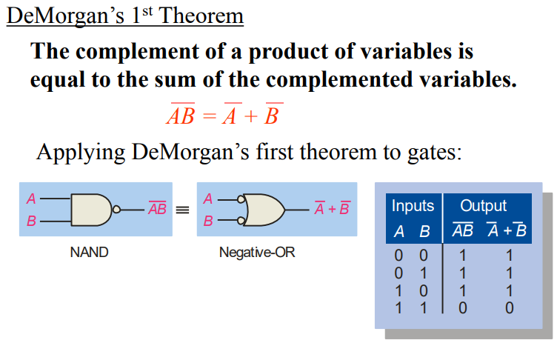
DeMorgan’s Theorem (1）
Prof. Yajun Ha
Notes:
Title

Slide 13
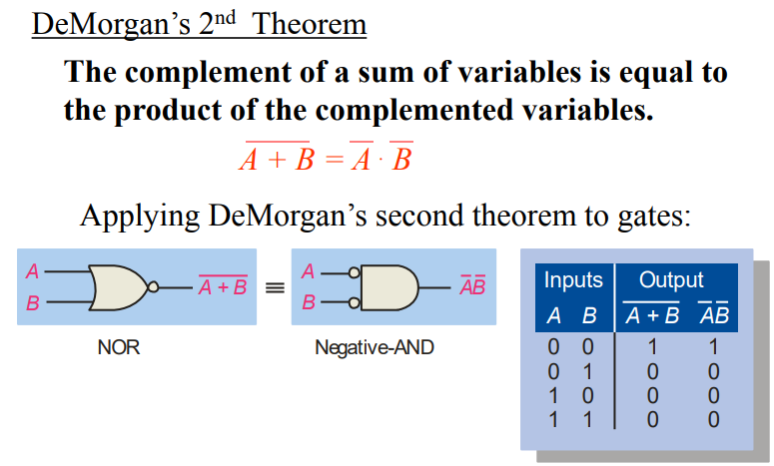
DeMorgan’s Theorem（2）
Prof. Yajun Ha
Notes:
Title

Slide 14
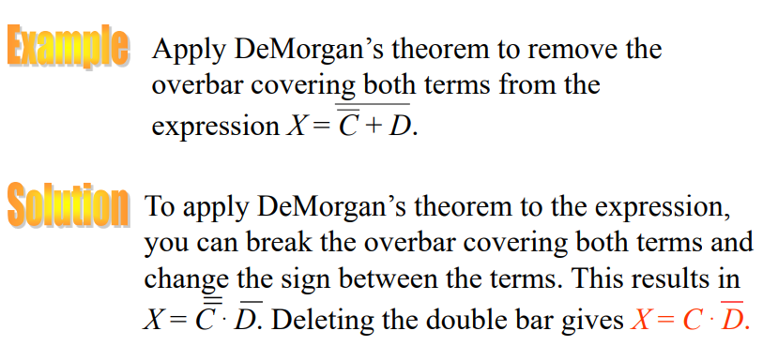
DeMorgan’s Theorem（3）
Prof. Yajun Ha
Notes:
Title

Slide 15

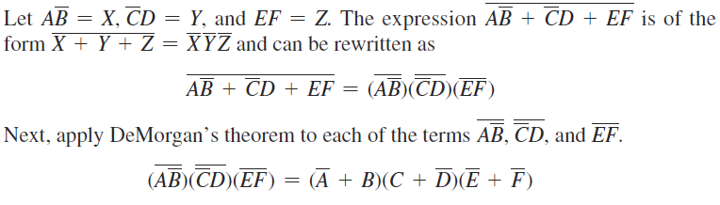
Example
Apply DeMorgan’s theorems.
Solution:
Prof. Yajun Ha

Slide 16
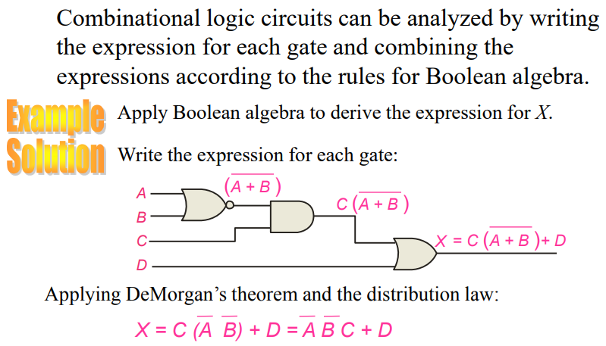
Boolean Analysis of Logic Circuits
Prof. Yajun Ha
Notes:
Title

Slide 17
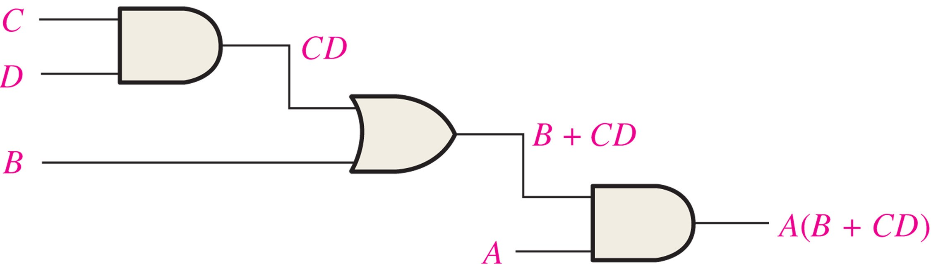
Example: Boolean expression for a logic circuit
____________________________________________
FIGURE 4-18 A combinational logic circuit showing the development of the Boolean expression for the output.

Slide 18
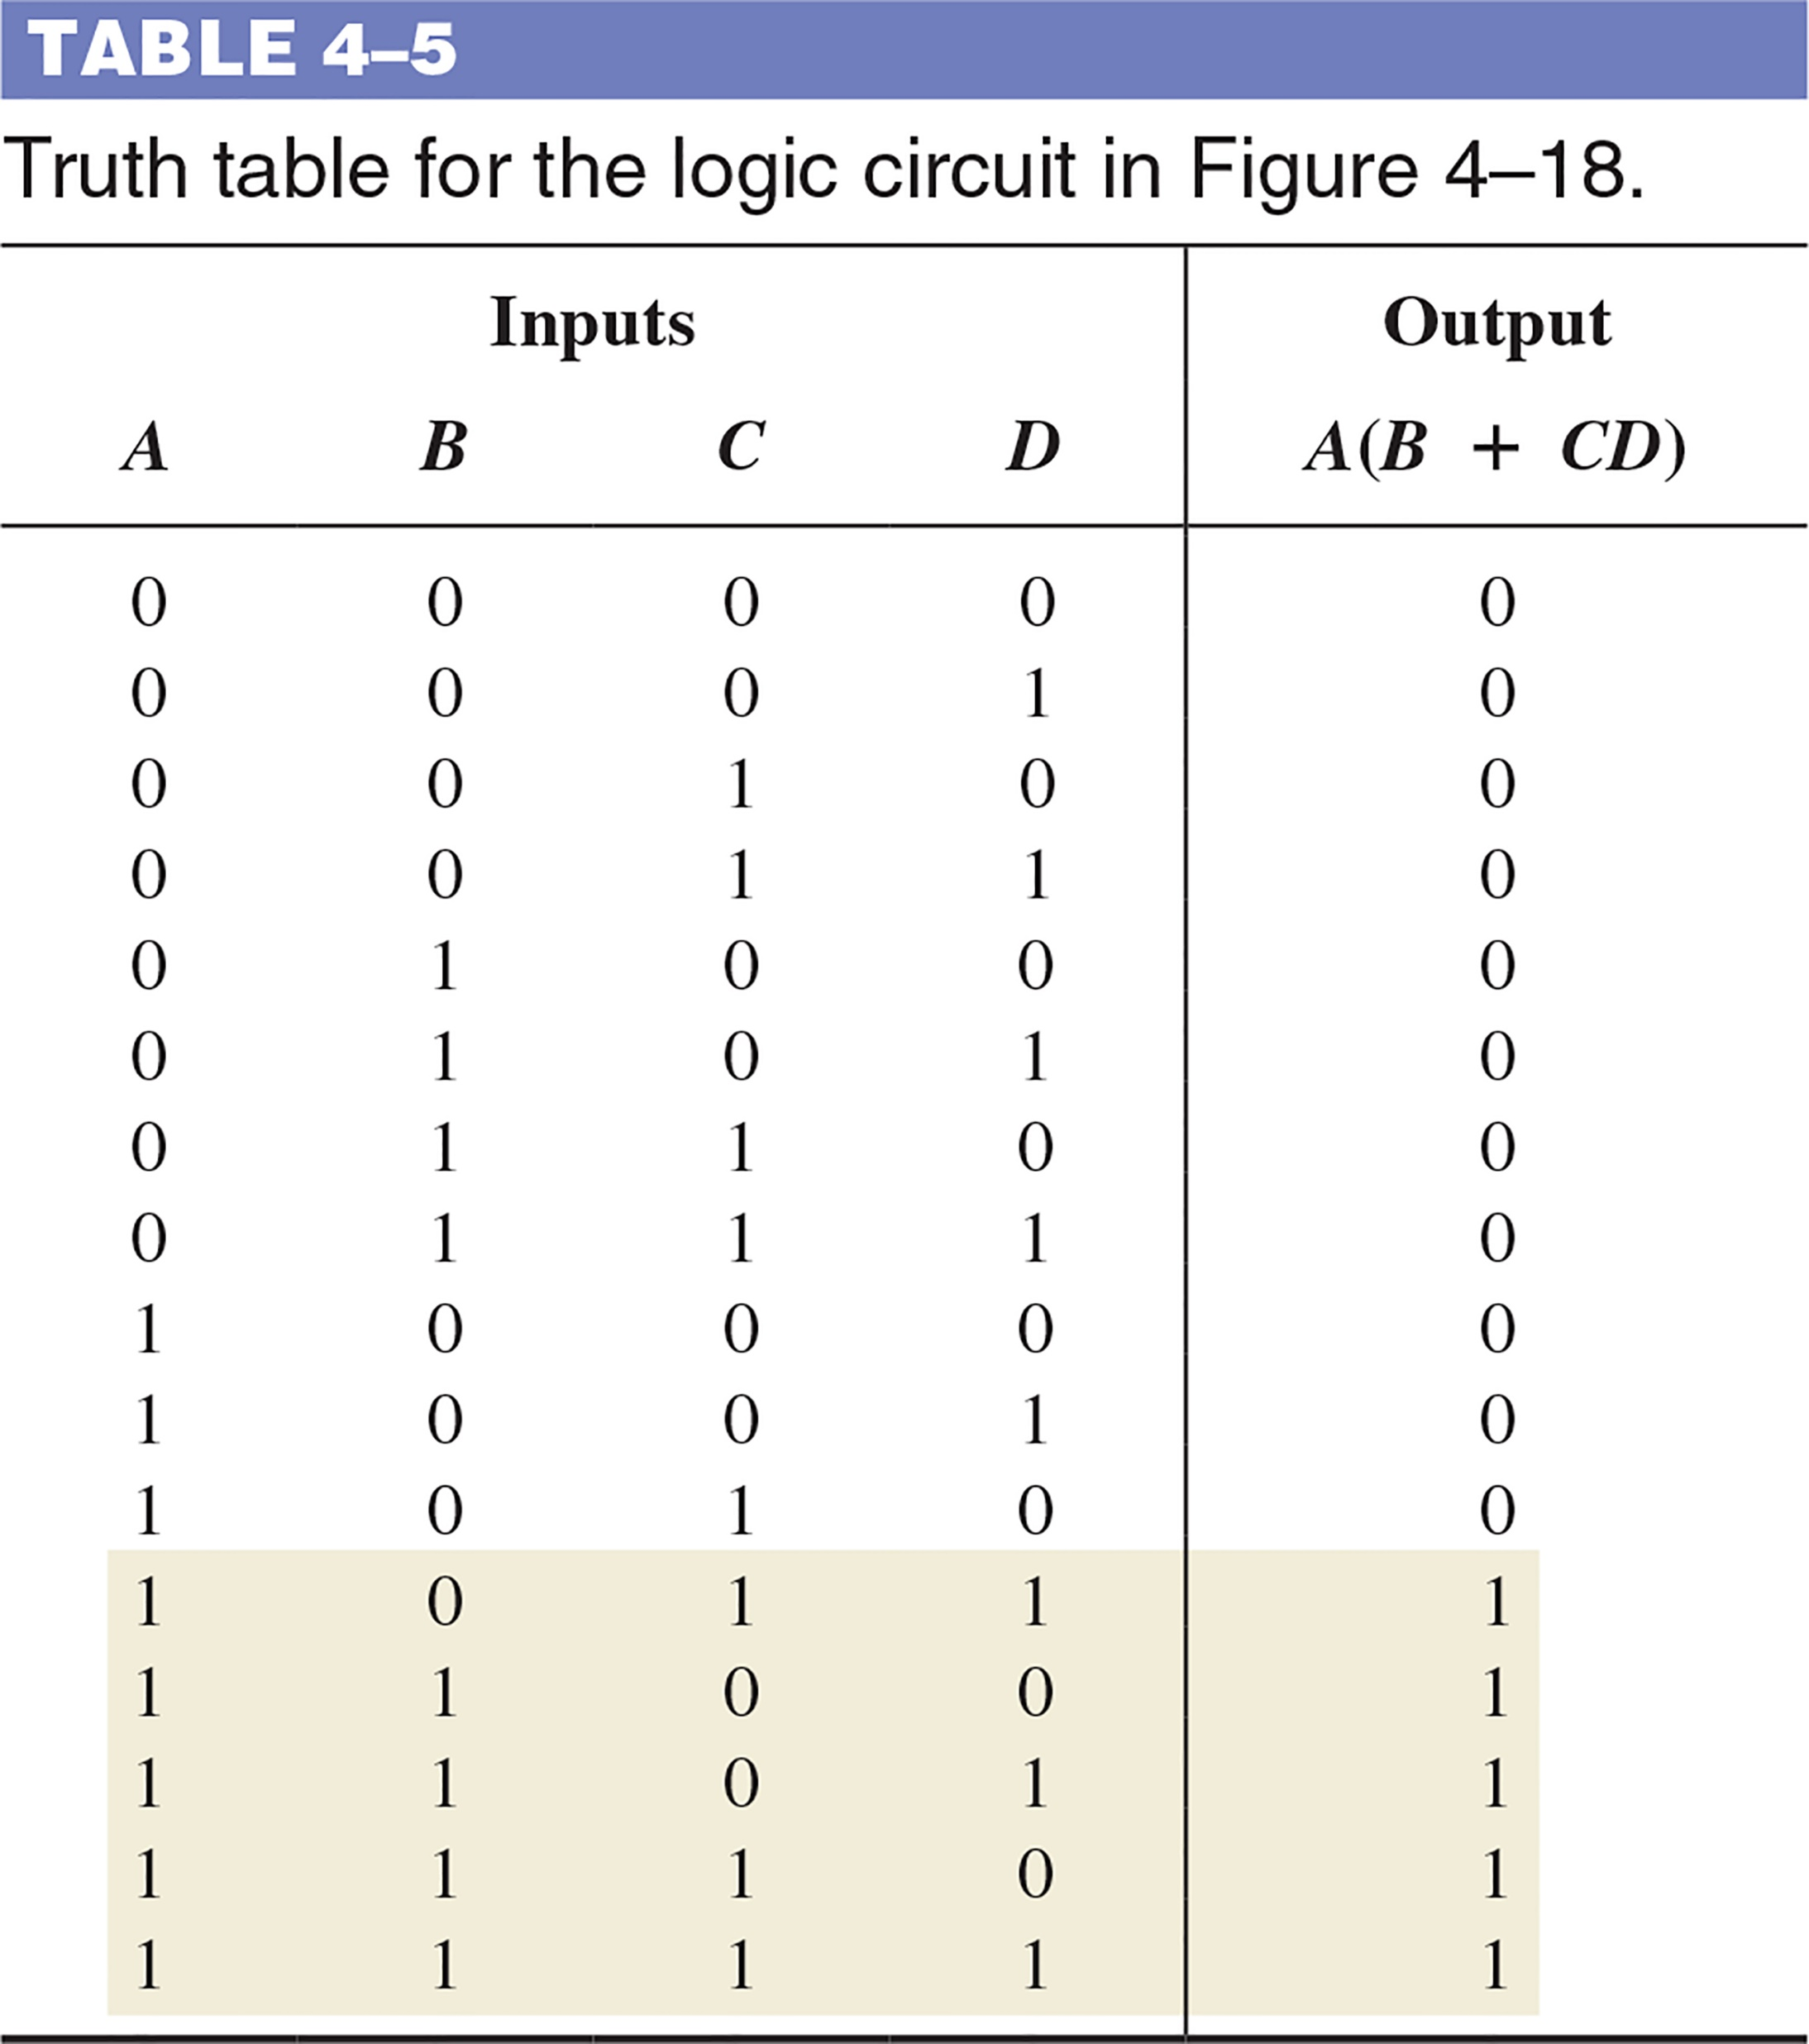
Example: Constructing a truth table for a logic circuit

Slide 19
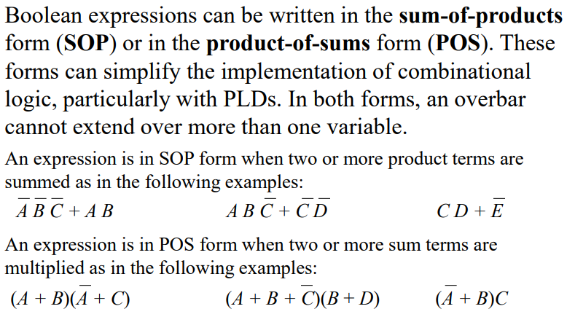
SOP and POS Forms
Prof. Yajun Ha
Notes:
Title

Slide 20
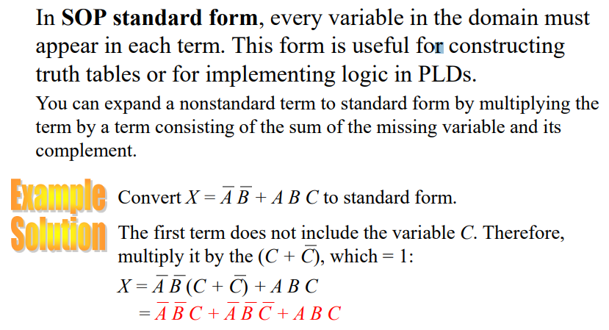
SOP Standard Form
Prof. Yajun Ha
Notes:
Title

Slide 21
2.5.3 逻辑函数的两种标准形式
最小项之和 最大项之积
最小项 m：
m是乘积项
包含n个因子
n个变量均以原变量和反变量的形式在m中出现一次
对于n变量函数
有2^{n}个最小项

Slide 22
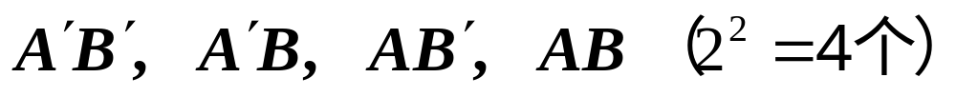
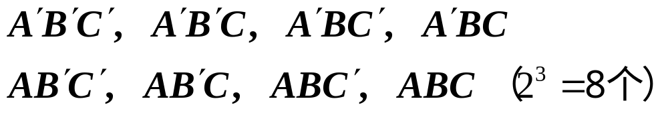
最小项举例：
两变量A, B的最小项
三变量A,B,C的最小项

Slide 23
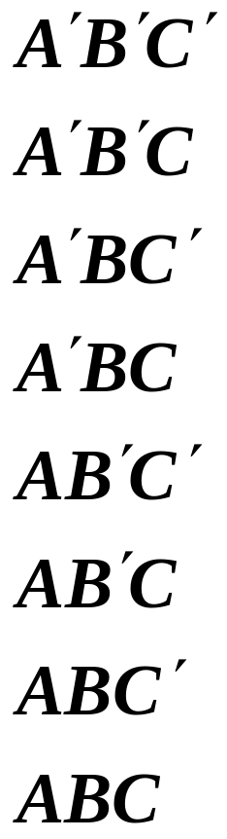
最小项的编号：
最小项 | 取值 | 对应 | 编号
 | A B C | 十进制数
 | 0 0 0 | 0 | m₀
 | 0 0 1 | 1 | m₁
 | 0 1 0 | 2 | m₂
 | 0 1 1 | 3 | m₃
 | 1 0 0 | 4 | m₄
 | 1 0 1 | 5 | m₅
 | 1 1 0 | 6 | m₆
 | 1 1 1 | 7 | m₇

